Slide 1
Fund Features: Alpha
Michael Tong

Slide 2
Outline
Are there any fund features that increase the odds of outperforming the index?
History
Background

Slide 3
Summary
Want to see if there are features of a fund that might lead to an increase chance that a fund will outperformance its benchmark in any given calendar year.
Data came from the Morningstar database

Slide 4
Summary
Screen for funds with an inception date prior to 2005.
Collect portfolio features at year end for each year between 2005 to 2015.
Collect calendar year return for each fund and the return of its benchmark
Create new column that takes difference between 1 yr return of fund and benchmark
Create new column that returns 1 if that column is positive and 0 if negative
For features that contain NaN, use average of feature.

Slide 5
Summary
Features (TTM – Trailing Twelve Months)
Price to Book
Price to Cashflow
Price to Earnings
Price to Sales
Debt to Capital
Net Margin
ROA
ROE
AUM
Number of Holdings
Turnover Ratio

Slide 6
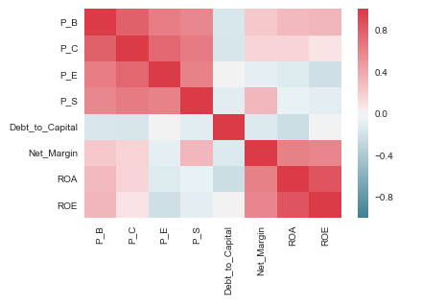
Modeling Insights
Feature Correlations

Slide 7
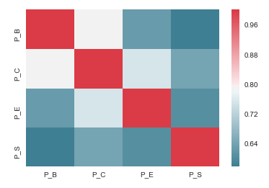
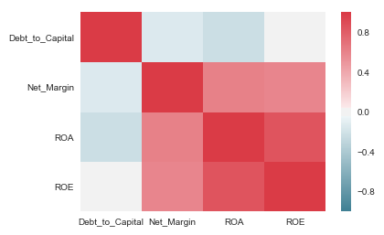
Modeling Insights
Feature Correlations (cont)

Slide 8
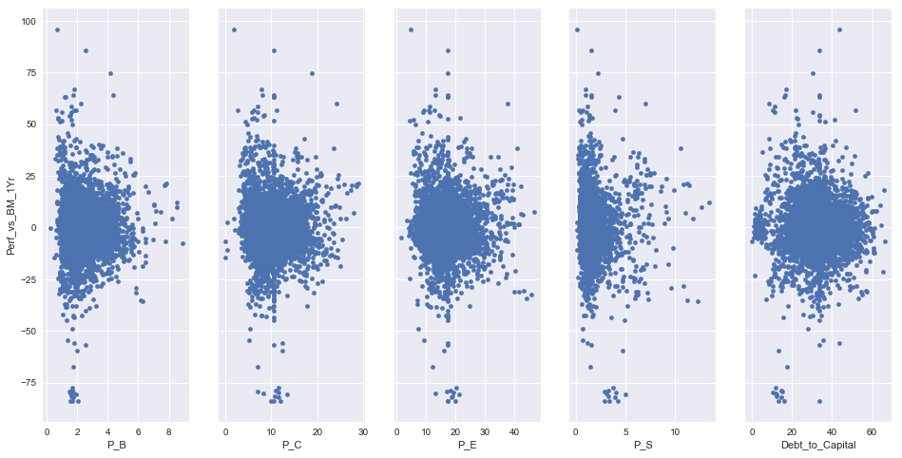
Modeling Insights
Feature vs Outperformance

Slide 9
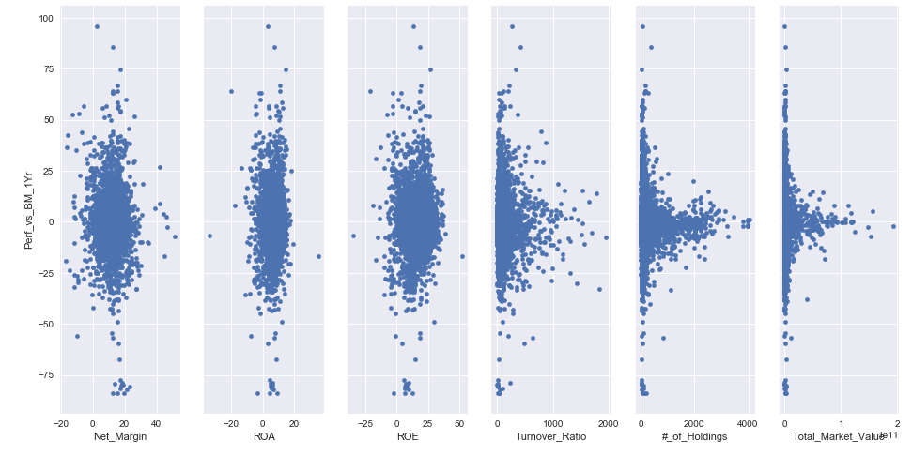
Modeling Insights
Feature vs Outperformance

Slide 10
Modeling Approach
Logistic Regression & Random Forest Classifier

Slide 11
Results
Logistic Regression
Scoring: Recall
Best Score: 0.443
Feature | Best Estimator Coefficient
Price to Book | 0.19
Price to Sales | 0.09
ROA | 0.06
AUM | 0.02
Turnover Ratio | -0.06
Debt to Capital | -0.09
Price to Earnings | -0.12
# of Holdings | -0.12
Price to Cash Flow | -0.17
ROE | -0.17

Slide 12
Results
Logistic Regression
Fit model to notable features
Create column with probability estimate for each row for those features.

Slide 13
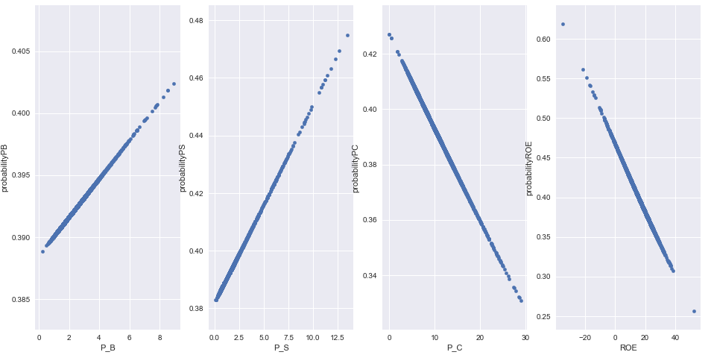
Results
Logistic Regression
Plot the probability estimate of top 2 and bottom 2 features, PB, PS, PC, ROE

Slide 14
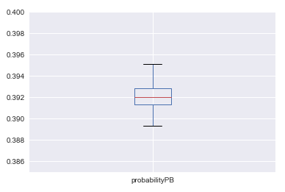
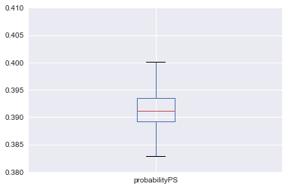
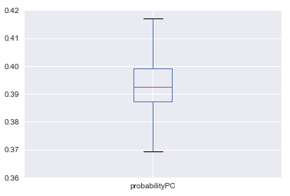
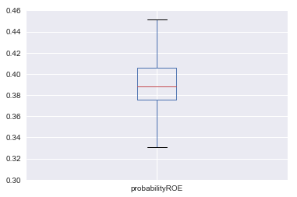
Results
Logistic Regression
Plot the probability estimate range of top 2 and bottom 2 features, PB, PS, PC, ROE

Slide 15
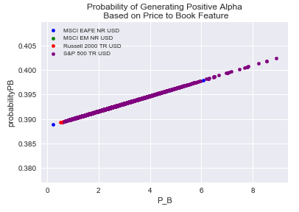
Results
Logistic Regression
Plot the probability estimate of the top feature

Slide 16
Results
Random Forest
Split data 25% test, 75% train
Train feature against Beat_BM_1Yr
Train score 0.9798
Test score 0.6665
Prediction array of first 10 test rows
Row | % correct | % incorrect
1 | 0.5 | 0.5
2 | 0.6 | 0.4
3 | 0.9 | 0.1
4 | 0.3 | 0.7
5 | 0.5 | 0.5
6 | 0.7 | 0.3
7 | 0.9 | 0.1
8 | 0.9 | 0.1
9 | 0.4 | 0.6
10 | 0.6 | 0.4

Slide 17
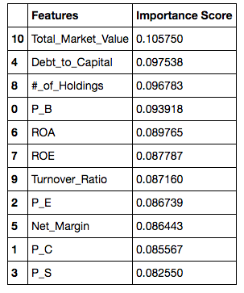
Results
Random Forest
Feature Importance

Slide 18
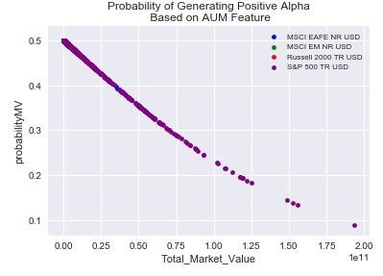
Results
Random Forest
Plot the probability estimate of top feature

Slide 19
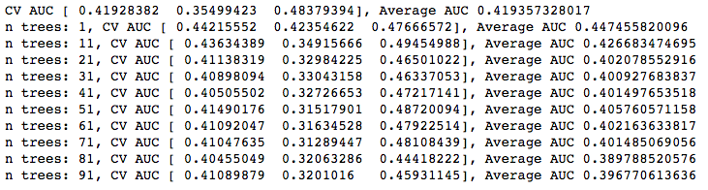
Results
Random Forest
Increase the number of estimators to see impact on predicative score

Slide 20
Conclusion

Slide 21
Next Steps
Survivorship bias
End point specific
Degree of outperformance
Focus on one asset class
Include additional, less popular features

